Slide 1
The military maintenance workforce: A simulation-based optimisation approach.

Slide 2
Topics
Introduction and Motivation
Discrete Event Simulation
Basic Workflow Utilised
Simulation Inputs and Outputs Available
Simulation-based optimisation
Basic of Genetic Algorithm (GA)
Computational Analysis
Unoptimised and Optimised Results
Sensitivity Analysis
1
Notes:
Topics covered today will be:
A brief overview on myself and the motivations for choosing this topic.
The basic overview of the workflow I have used within the DES. Other options available for utilisation in the DES.
The optimisation algorithm utilised to couple with the DES.
Analysis of results

Slide 3
Introduction
Fourth-year undergrad currently studying full time Electrical Engineering (Honours).
Major and Minor Fleet experience in conjunction with support repair facilities (FIMA and FSU).
Motivation.
Closed loop maintenance workforce considerations.
On the job training incorporation.
2
Notes:
LEUT Kurt Withers
In my fourth year of an Electrical Engineering Degree undertaking my honours component.
Past history is serving on minor vessels in Cairns before transitioning to major vessels in the Sydney region. Technical shore billets have been in the FIMA workshops and FSU Planning Cell.
Motivation - wanting to investigate a Defence specific problem an increase my understanding of simulation and optimisation process. Main motivation for workforce planning came from my time within FSU Planning Cell and whilst the Regulator onboard HMAS Newcastle for the Weapons Electrical team. I saw a lot of core knowledge and technical expertise loss as core members posted in and out.
Why - As new capabilities are introduced, new strategies may be required to meet their maintenance needs. The strategies looked at within my thesis provide me with a understanding for upcoming leadership roles and a different way of planning human resources.

Slide 4
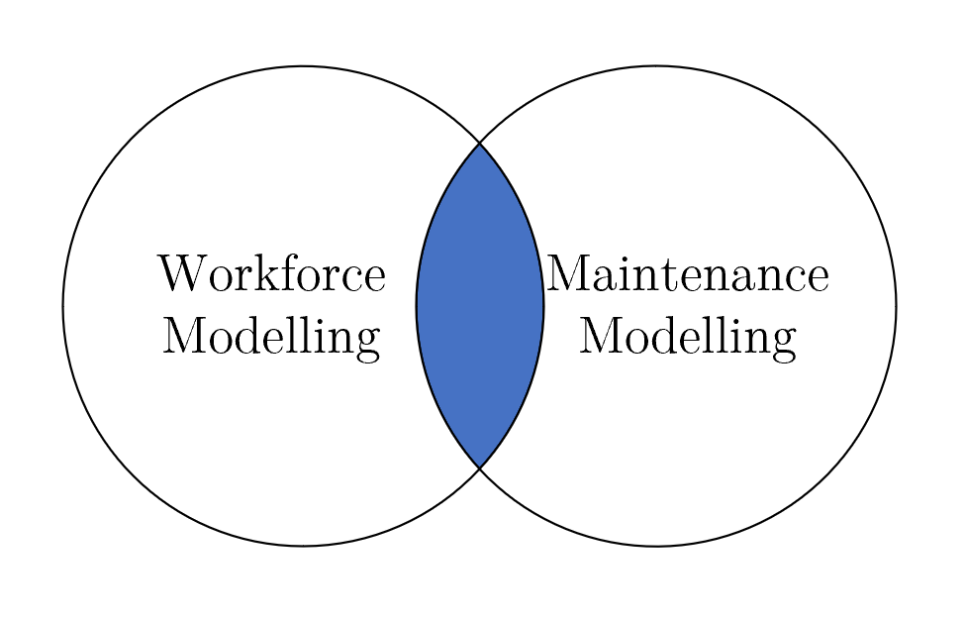
Thesis Goals
Closed loop considerations of the military environment.
Utilising a workforce model that incorporates the maintenance environment.
Analyse a military maintenance workshop that is responsible for the critical asset maintenance of a high risk operational assets.
3
Notes:
Closed loop considerations:
Workforce grown from within
Not easily replaced
Single Workshop only. Not looking at entire stream.
Needed to include OJT.
Personal reasons – Improve simulation knowledge, optimisation process and coding skills with a new language (python).

Slide 5
Simulation
Simulate a maintenance support facility looking after Planned Maintenance for critical assets.
Analyse the RFI stores maintained over a 10 year period
Look at altering posting lengths of the workforce.
Look at altering workforce composition to include APS members and the associated benefits to mixed partner working.
Include on the job training which is a critical component of the maintenance workforce within the military environment.
4
Notes:
Closed loop considerations:
Workforce grown from within
Not easily replaced
Single Workshop only. Not looking at entire stream.
Needed to include OJT.
Personal reasons – Improve simulation knowledge, optimisation process and coding skills with a new language (python).

Slide 6
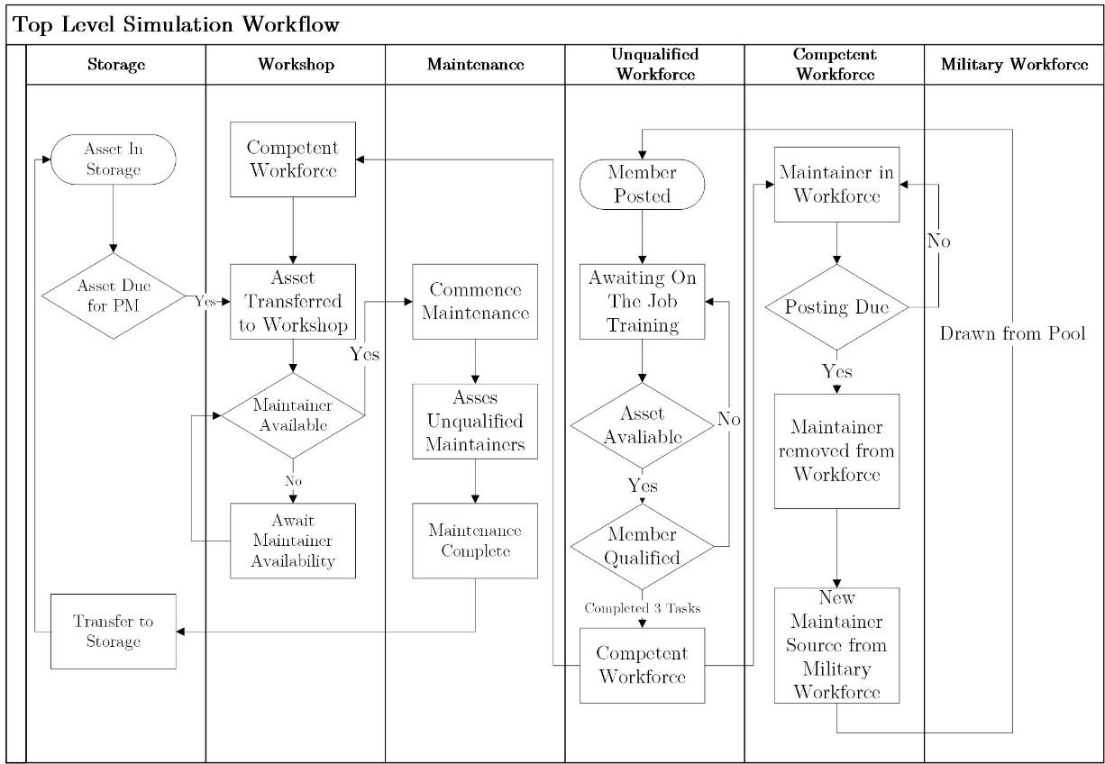
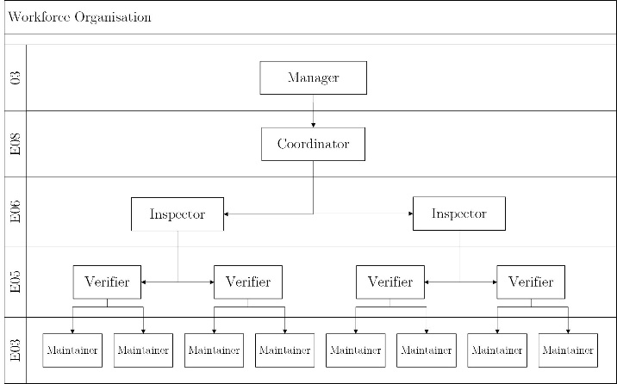
Discrete Event Simulation (DES) Workflow
Assumptions
Starting Conditions
Asset Availability
Resource Availability
On the Job Training
Military Workforce
Australian Public Service
5
Notes:
LHS Maintenance
RHS Workforce.
Look at notes to hit key points in assumption!
Hit speed of model per run – Anywhere from a few seconds up to a few minutes for more complex scenarios.

Slide 7
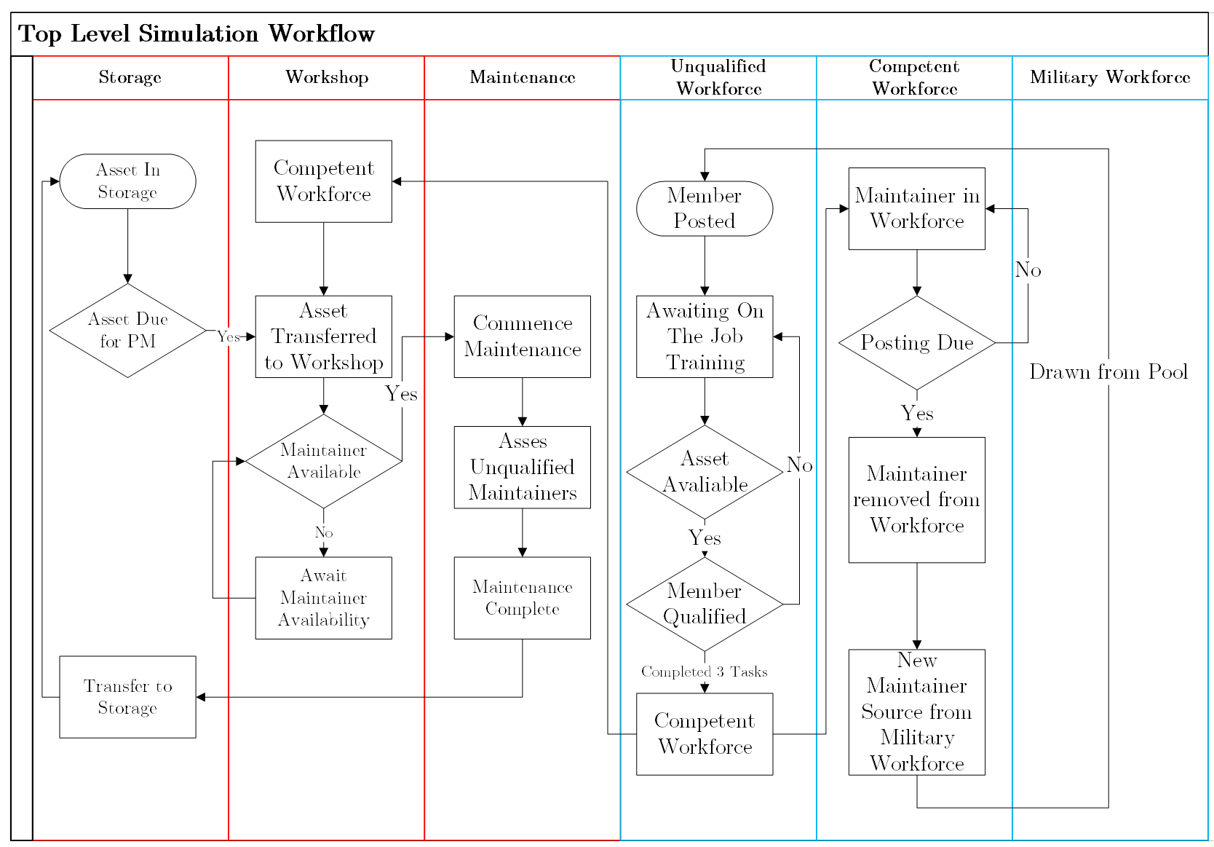
Discrete Event Simulation (DES) Workflow
Assumptions
Starting Conditions
Asset Availability
Resource Availability
On the Job Training
Military Workforce
Australian Public Service
Maintenance
Workforce
6
Notes:
The higher-level simulation model is shown and here it can be seen that the model can be broken down into two separate interacting sections.
The first consists of the workflow for the maintenance being conducted.
All assets start within the storage facility requiring maintenance at the start of each simulation.
Assets due for maintenance are transferred to the workshop at a set rate and the competent workforce is checked for availability to conduct maintenance.
When maintainers are available to conduct maintenance, they are removed from the available pool of maintainers and commence the maintenance.
At this point within the simulation there is a stop to see if there is any untrained workforce available to conduct OJT, if so, they are also assigned to the maintenance.
When the maintenance has been completed the asset is returned to the storage facility.
The asset will remain in a RFI state until time has advanced in the simulation to trigger the next maintenance window.
A record of available assets is also kept as time progress to see how effective the workshop is at maintaining available assets and ensuring RFI status of assets.
The second workflow consists of accounting for the posting cycle of incoming members and checking if a member can be moved from the untrained to the competent workforce for utilisation.
While a member is deemed as competent, they will be available to conduct maintenance as assets become available dependant on their maximum utilisation variable.
After a designated posting period the competent member will be replaced with an untrained member to simulate a posting cycle.
OJT of untrained members requires an asset available for maintenance in addition to a trained member able to supervise the OJT.
Once the maintenance of the asset is complete the untrained member is checked for the required number of competencies.
If this criterion is meet, the member is moved from the unqualified workforce to the competent workforce.
If the required number of competencies is not meet the member remains in the unqualified workforce section awaiting further training.

Slide 8
Discrete Event Simulation – Additional Inputs
Holidays
Approval Delays
Multi Asset Conditions
Multiple Asset Conditions
Acquisition
Resource Requirement
Maintenance Scheduling
Test Conditions
Storage and floor space
Multi Facility/Workshop use
Maintenance Tasks
Resources
Acquisition
Starting Conditions
Failure Rates
Asset Maintenance Tasks
Time
Workforce Requirement
Total asset maintenance cost
OJT Requirements
Workforce
Individual level breakdowns
Promotion
Task requirements
Type
Initial Workforce conditions
Facilities
Size
Weight
7

Slide 9
Discrete Event Simulation – Additional Inputs
Holidays
Approval Delays
Multi Asset Conditions
Multiple Asset Conditions
Acquisition
Resource Requirement
Maintenance Scheduling
Test Conditions
Storage and floor space
Multi Facility/Workshop use
Maintenance Tasks
Resources
Acquisition
Starting Conditions
Failure Rates
Asset Maintenance Tasks
Time
Workforce Requirement
Cost
OJT Requirements
Workforce
Individual level breakdowns
Promotion
Task requirements
Type
Initial Workforce conditions
Facilities
Size
Weight
8

Slide 10
Discrete Event Simulation – Additional Outputs
Asset Delivery
Ontime
Backlog
Asset States
Workforce
Composition
In certification Maintainers
Certification lost
Maintainer promotions
Resource Planning
Usage
Delayed Tasks
Backlog Tasks
Cost
Rework/Task/Total
Assets
Section Usage
Track Asset Locations
Technicians
Number at each Level
Technician States
Time Idle
Facilities
Floor Space
Material used
Activity
9

Slide 11
Discrete Event Simulation – Additional Outputs
Asset Delivery
Ontime
Backlog
Asset States
Workforce
Composition
In certification Maintainers
Certification lost
Maintainer promotions
Resource Planning
Usage
Delayed Tasks
Backlog Tasks
Cost
Rework/Task/Total
Assets
Section Usage
Track Asset Locations
Technicians
Number at each Level
Technician States
Time Idle
Facilities
Floor Space
Material used
Activity
10

Slide 12
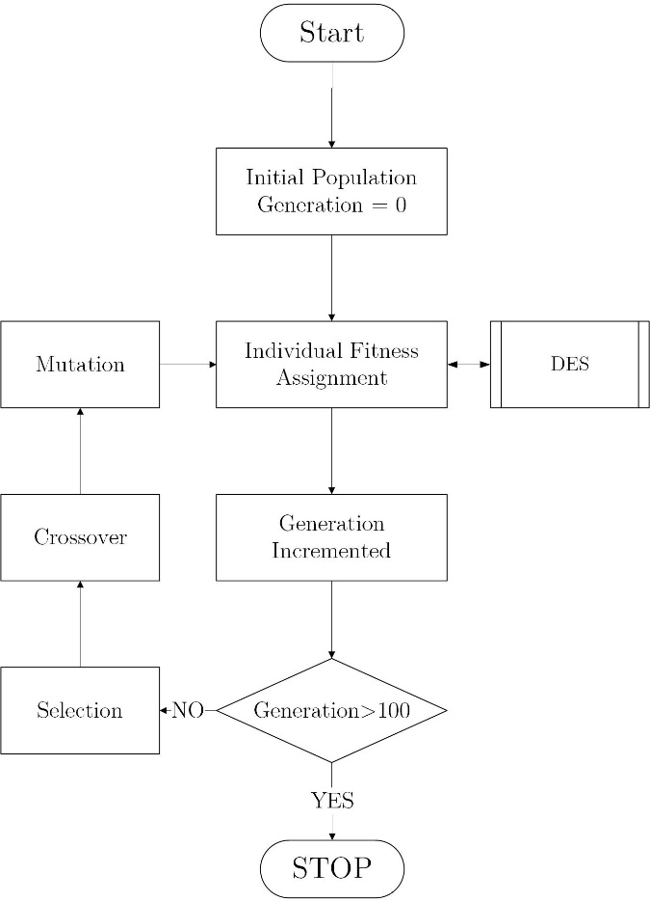
Simulation-based Optimisation
Genetic Algorithm
Optimising Asset Injection.
Assets per Event
Events per Year
Initial code is written to be expandable and utilised for further studies.
11
Notes:
An initial population is created with the assets per event and events per year converted into a binary representation in order to fill a population of individuals. Once complete each set of values is converted into the associated integer value and utilised within the simulation run for the selected posting policy or workforce composition. On completion, the mean and range of the RFI stores are utilised in order to assign a fitness value for the associated individual of the population. This fitness value is utilised to evaluate the individual and measure it's viability for crossover and mutation to create offspring for use in further generations.
An initial population is created with the assets per event and events per year converted into a binaryrepresentation in order to fill a population of individuals as seen in Figure 4. Once complete each set ofvalues is converted into the associated integer value and utilised within the simulation run for the selectedposting policy or workforce composition. On completion, the mean and range of the RFI stores are utilisedin order to assign a fitness value for the associated individual of the population. This fitness value is utilisedto evaluate the individual and measure it’s viability for crossover and mutation to create offspring for use in further generations.
A tournament selection is then utilised on the population to select individuals for reproduction andfurther genetic modification. This utilises a function in which individual values are chosen at random fromwithin the population and compared, individuals with higher fitness values are more likely to be selected asthe winner. In this way, even a candidate with a lower fitness value maybe selected for further crossover andmutation which may yield a higher fitness value in future generations.A one point crossover function is applied to the selected parents to produce offspring. This functionselects one bit within both offspring and designates that point as the crossover point. All bits to the right ofthe selected point in both offspring are then swapped as shown in Figure 5. The resultant is two offspringthat each contain some part of the original information from the parents (Luke, 2013).
After crossover, a mutation function is applied to individuals selected at random as seen in Figure 6.The individual selected will have a random probability for each binary value to be flipped from it’s originalstate. This operation generally ensures that populations are not caught in local maximums/minimums andexplore further individuals that may find the global maximum/minimum (Turan et al., 2020).

Slide 13
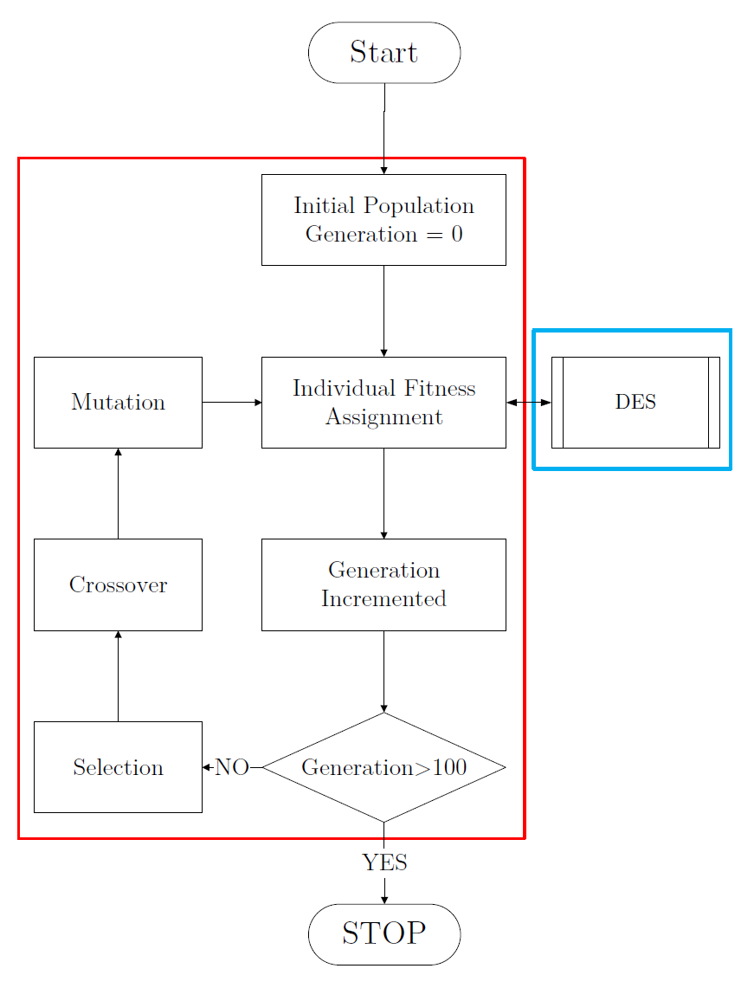
Simulation Based Optimisation
Genetic Algorithm
DES utilised in order to assign the fitness value.
Optimising Asset Injection.
Initial code is written to be expandable and utilised for further studies.
Important to note that any optimisation code could be utilised. DES is capable of integrating and stands alone.
12
Notes:
Important to note that the DES and optimisation process stand separately from each other. Should another optimisation process be preferred then it can be implemented. Not locked into using GA.

Slide 14
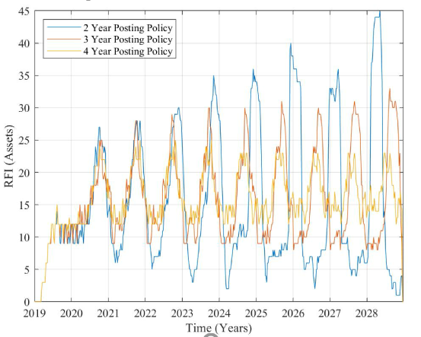
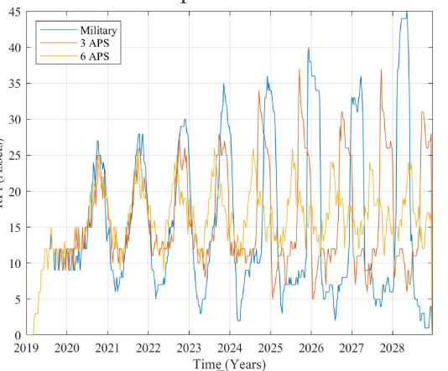
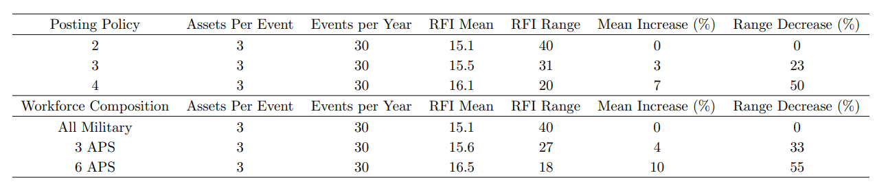
Computational Analysis – Set Injection
Posting Policy – Simulation Results
Workforce Composition– Simulation Results
.
13
Notes:
Notable outcomes from using set asset injection.
LHS results indicate that when asset injection is not optimised that a posting policy with a larger time between posting of personnel has a 7% increase on the RFI stores mean and a 50% decrease on the range.
This is in part due to the decreased down time of staff due to OTJ training requirements.
When comparing a mixed technical workforce it can be seen that by only changing 25% of the junior workforce (E03 and E02) that the RFI mean and range are comparable to extending the workshops posting cycle by a one year period.
The same can also be said by replacing 50% of the workshop workforce, here this has a comparable effect of extending the 2 year posting to a 4 year posting.
Analysis indicates that when asset transfer cannot be aligned to workshop composition, due to being either unknown or operational requirement set, that extending the time between postings will allow for improved asset maintenance consistency. If the operation allowed, incorporation of non military staff would also see beneficial results comparable to those of extending a military members posting. Both show that simulation of the workforce will prove beneficial.
As a posting policy is extended there is less hours accounted utilised by the untrained workforce and more hours associated to the trained workforce resulting in an increased RFI mean. The reduction in range is also due to the reduced OJT requirements, this results in more trained workforce able to conduct the required steps for asset planned maintenance completion at the scheduled delivery maintenance windows. Thus a more consistent completion of assets at the scheduled times rather then creating a backlog of assets that have their associated PM tasks completed at in conjunction with other asset delivery windows.

Slide 15
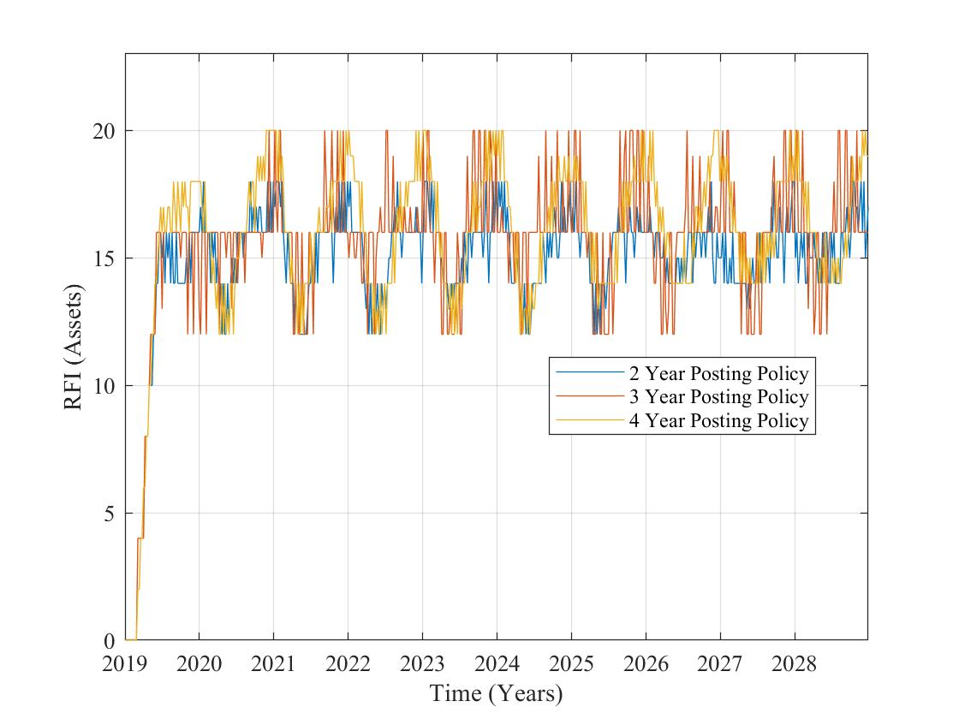
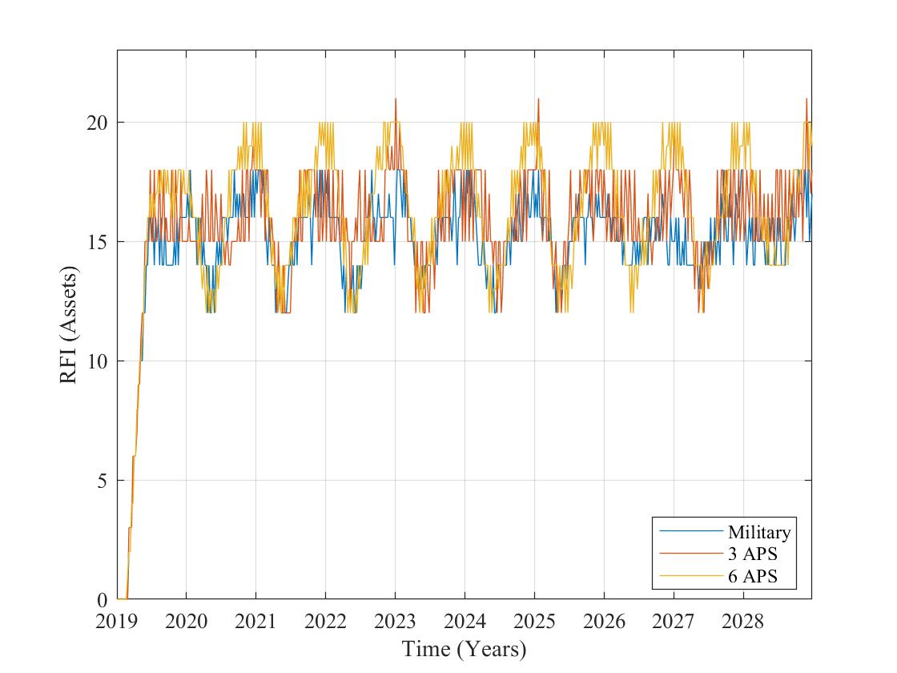
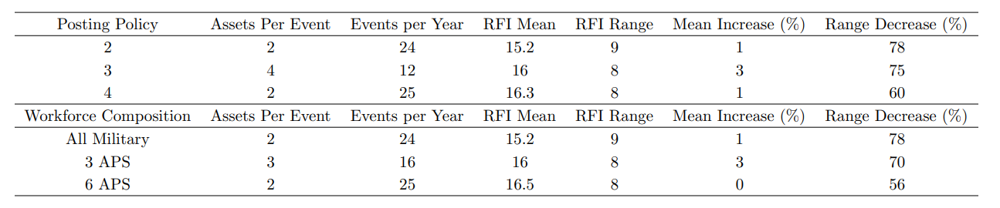
Computational Analysis – Optimised Injection
Posting Policy – SBO Results
Workforce Composition– SBO Results
.
14
Notes:
HIT:
Slight mean increase.
Large range decrease.
Reduced amount of critical assets to have similar unoptimised results. Up to 45%!

Slide 16
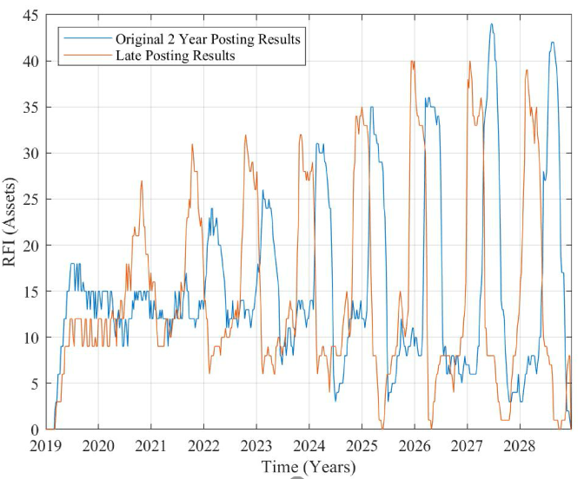
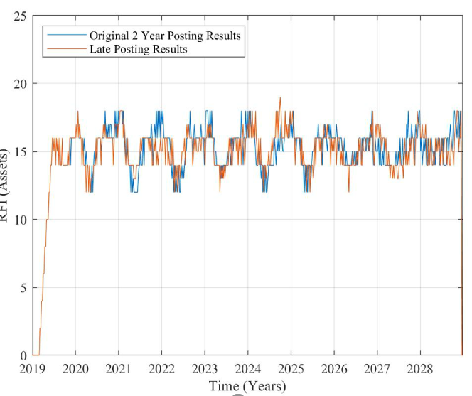
Computational Analysis – Sensitivity Analysis
Unoptimised Scenario
Optimised scenario
.
15
Notes:
Allowed for a sensitivity analysis.
Effectively any member that is posted is not actually replaced until approximately one month after they should be.
Shows that the optimised circumstances are more resilient to a member not being posted in time.

Slide 17
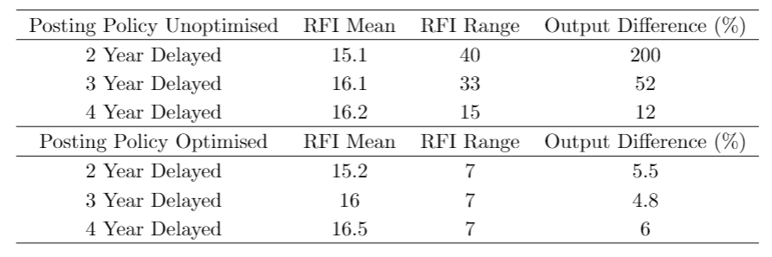
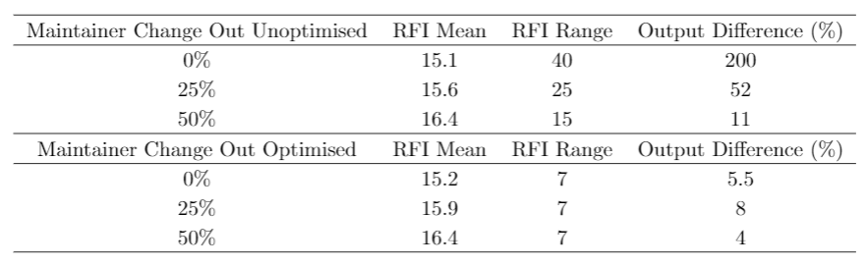
Sensitivity Analysis
Posting Policy Sensitivity
Mixed Workforce Sensitivity
16
Notes:
Sensitivity analysis was undertaken in order to identify the effect of posting a member in late. The average miss alignment of postings was set at 1 month, therefore a posted member was not replaced until after approximately 1 month of simulation time had elapsed.
Results show that the optimised scenarios show greater robustness to these conditions.

Slide 18
Further Research Potential
Removal of Assumptions:
Resources
Add in defective maintenance
Broaden simulation to encompass multiple workshops.
Optimisation
Incorporating workforce composition to optimise output and total cost.
Overlap between members being posted.
17
Notes:
Topics covered today will be:
A brief overview on myself and the motivations for choosing this topic.
The basic overview of the workflow I have used within the DES. Other options available for utilisation in the DES.
The optimisation algorithm utilised to couple with the DES.
Analysis of results

Slide 19
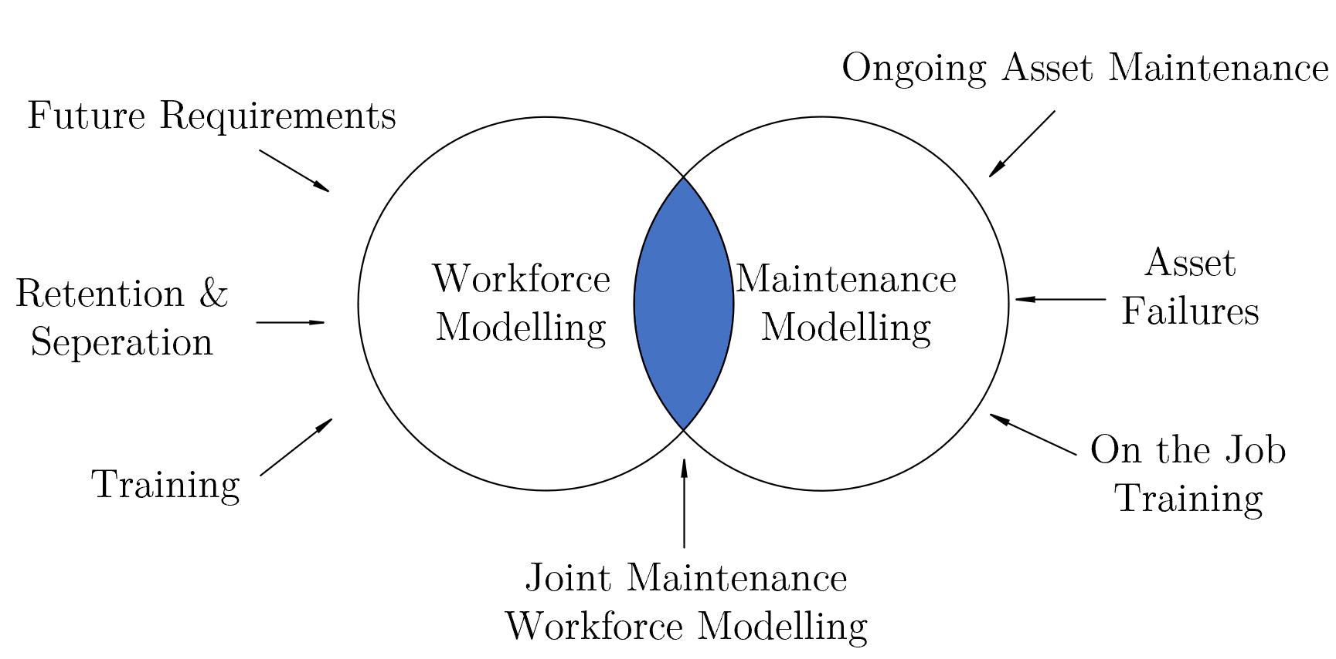
Closed Loop Maintenance Workforce
Improved reliability of critical asset availability.
Reduce critical asset acquisition to meet capability requirements
Reduced asset cost due to reliable maintenance and asset acquisition.
A greater understanding on the closed loop workforce requirements.
18
Notes:
Topics covered today will be:
A brief overview on myself and the motivations for choosing this topic.
The basic overview of the workflow I have used within the DES. Other options available for utilisation in the DES.
The optimisation algorithm utilised to couple with the DES.
Analysis of results

Slide 20
Closed Loop Maintenance Workforce
To understand the complex military maintenance workforce there needs to be an intersection of workforce and maintenance modelling.
This will allow strategic analysis of the underpinning workforce and maintenance requirements to meet the capability objectives set for Defence.
19

